Slide 1

Spring Boot - Tracing Micro Service Logs
Post man client
SpringBootRestTemplateDemo
SpringBootDemo
Using Rest Template Call the SpringBootDemo application
REST End points and get the result
Get the Employee details
[SpringBootRestTemplateDemo,28f68c12d9c9a6a0,28f68c12d9c9a6a0,false]
[SpringBootDemo,28f68c12d9c9a6a0,3446e03e76e36621,false]

Slide 2

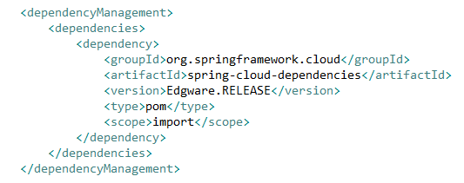
Spring Boot - Tracing Micro Service Logs
Most developers face difficulty of tracing logs if any issue occurred. This can be solved by Spring Cloud Sleuth and ZipKin server for Spring Boot application.
Spring cloud Sleuth logs are printed in the following format [application-name, traceid, spanid, zipkin-export]
Application-name = Name of the application
Traceid = each request and response traceid is same when calling same service or one service to another service.
Spanid = Span Id is printed along with Trace Id. Span Id is different every request and response calling one service to another service.
Zipkin-export = By default it is false. If it is true, logs will be exported to the Zipkin server.
[SpringBootRestTemplateDemo,28f68c12d9c9a6a0,28f68c12d9c9a6a0,false]
[SpringBootDemo,28f68c12d9c9a6a0,3446e03e76e36621,false]

